Slide 1
Consumer Price Index (CPI)

Slide 2
Agenda
Introduction
Questions !
Answers !
References

Slide 3
Introduction
The Consumer Price Index (CPI) :
is a measure of the average change over time in the prices paid by urban consumers for a market basket of consumer goods and services.
Ask questions first
01
Great questions help you focus on relevant parts of your data and direct your analysis towards meaningful insights.
02
Answers
Create visualizations with the goal of addressing the research questions that you posed in the Question section
References
03
is a source of information about a subject.

Slide 4
Introduction
Questions !
Answers !
References

Slide 5
Ask questions
Is the value of CPI in the world increasing over time or decreasing?
1
4
In the last 20 years What are the top ten countries in terms of CPI?
2
5
Does the CPI of Saudi Arabia is higher than the average CPI of the world over time?
In the last 20 years What are the least ten countries in terms of CPI?
3
Does the Income level affect the CPI?

Slide 6
Introduction
Questions !
Answers !
References

Slide 7
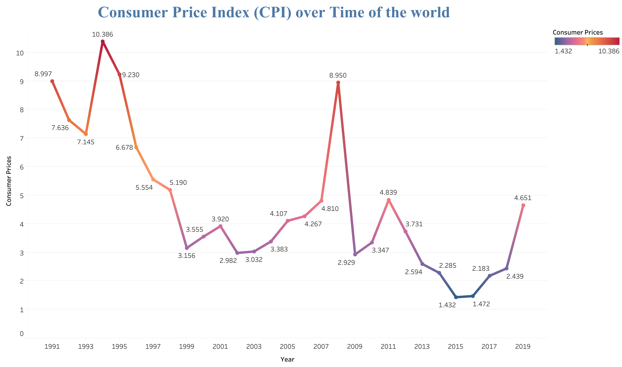
Answer Q 1 : Is the value of CPI in the world increasing over time or decreasing?
Answer Here
The value of CPI from thirty years is Decreasing, except in 2008 there was an unusual change, and after research on the most important events that happened to the world in 2007-2008 i think the main reason for this change is financial crisis
What happened during the financial crisis?
Referred to as the worst economic disaster
since the Great Depression, the 2008 financial
crisis devastated the world economy.
This resulted in what's known as the Great
Recession

Slide 8
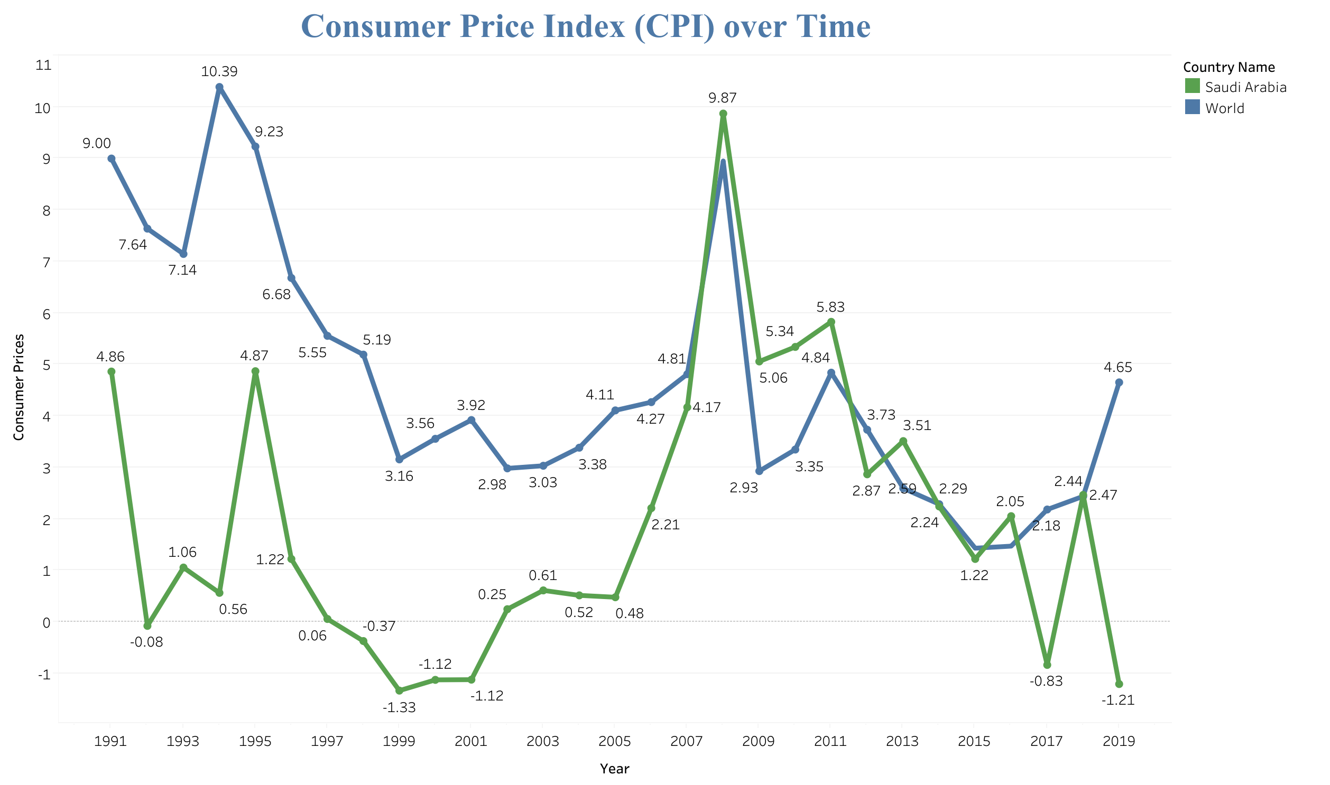
Answer Q 2 : Does the CPI of Saudi Arabia is higher than the average CPI of the world over time?
Answer Here
The Saudi Arabia from 1990 to 2008 was less than the world, but after 2008 became almost closely with the world

Slide 9
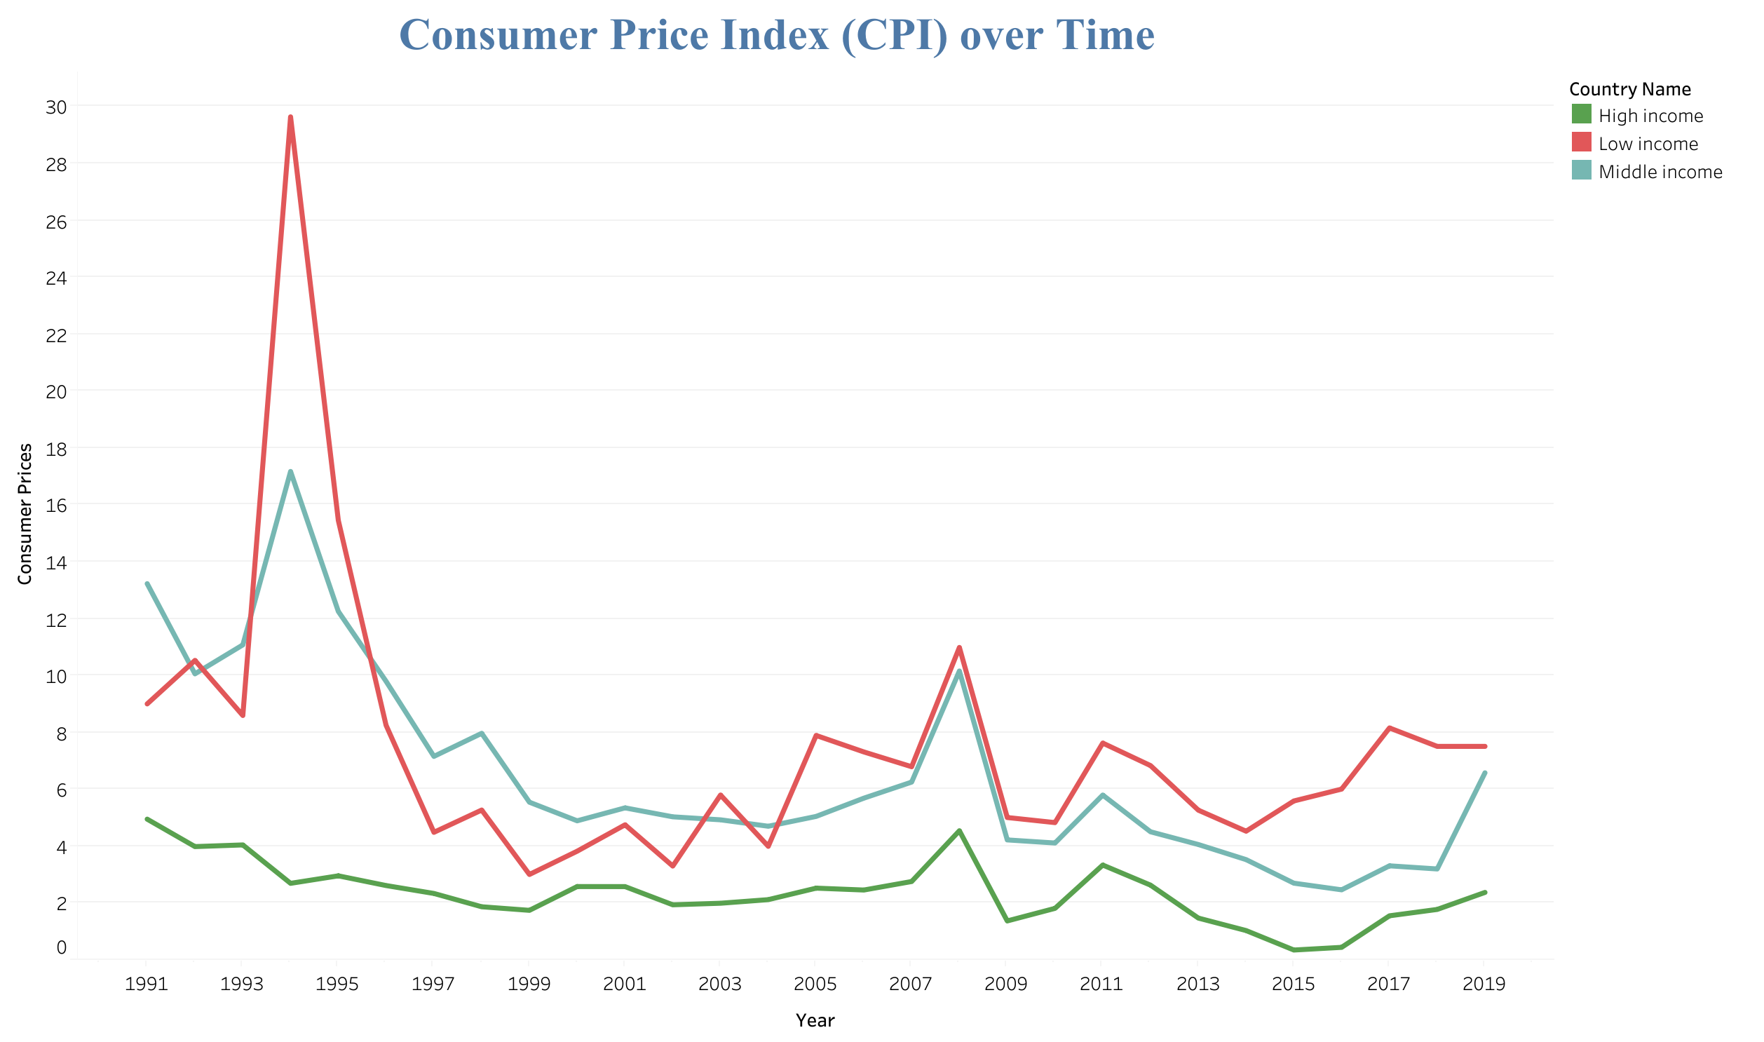
Answer Q 3 : Does the Income level affect the CPI?
Answer Here
whenever higher the level of income then CPI decreasing and become more stable
1- High income , Low CPI
2- Middle income , Moderate CPI
3- Low income , Hight CPI
Income : Net profit, or money that remains after expenses are subtracted from revenue.
Revenue :Proceeds from the sales of products and services to customers, as well as other activities like investment.

Slide 10
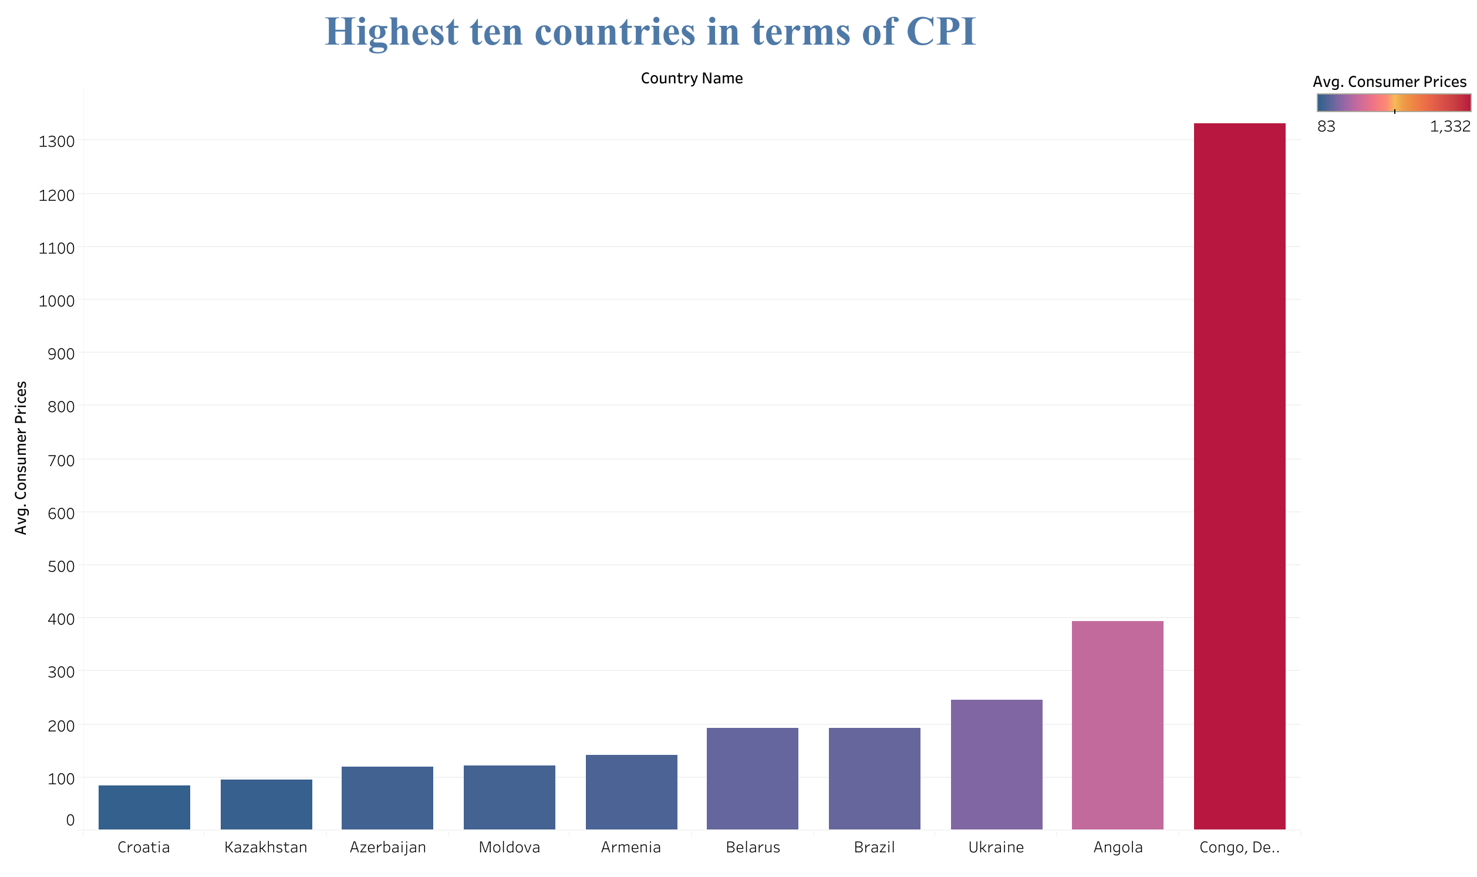
Answer Q 4: What are the top ten countries in terms of CPI?
Answer Here
1. CONGO DEM. REP
2. ANGOLA
3. UKRAINE
4. BRAZIL
5. BELARUS
6. ARMENIA
7. MOLDOVA
8. AZERBAIJA
9. KAZAKHSTAN
10. CROATIA
GDP of these countries is low compared with the countries of the world
I think the poverty rate is related in terms of CPI

Slide 11
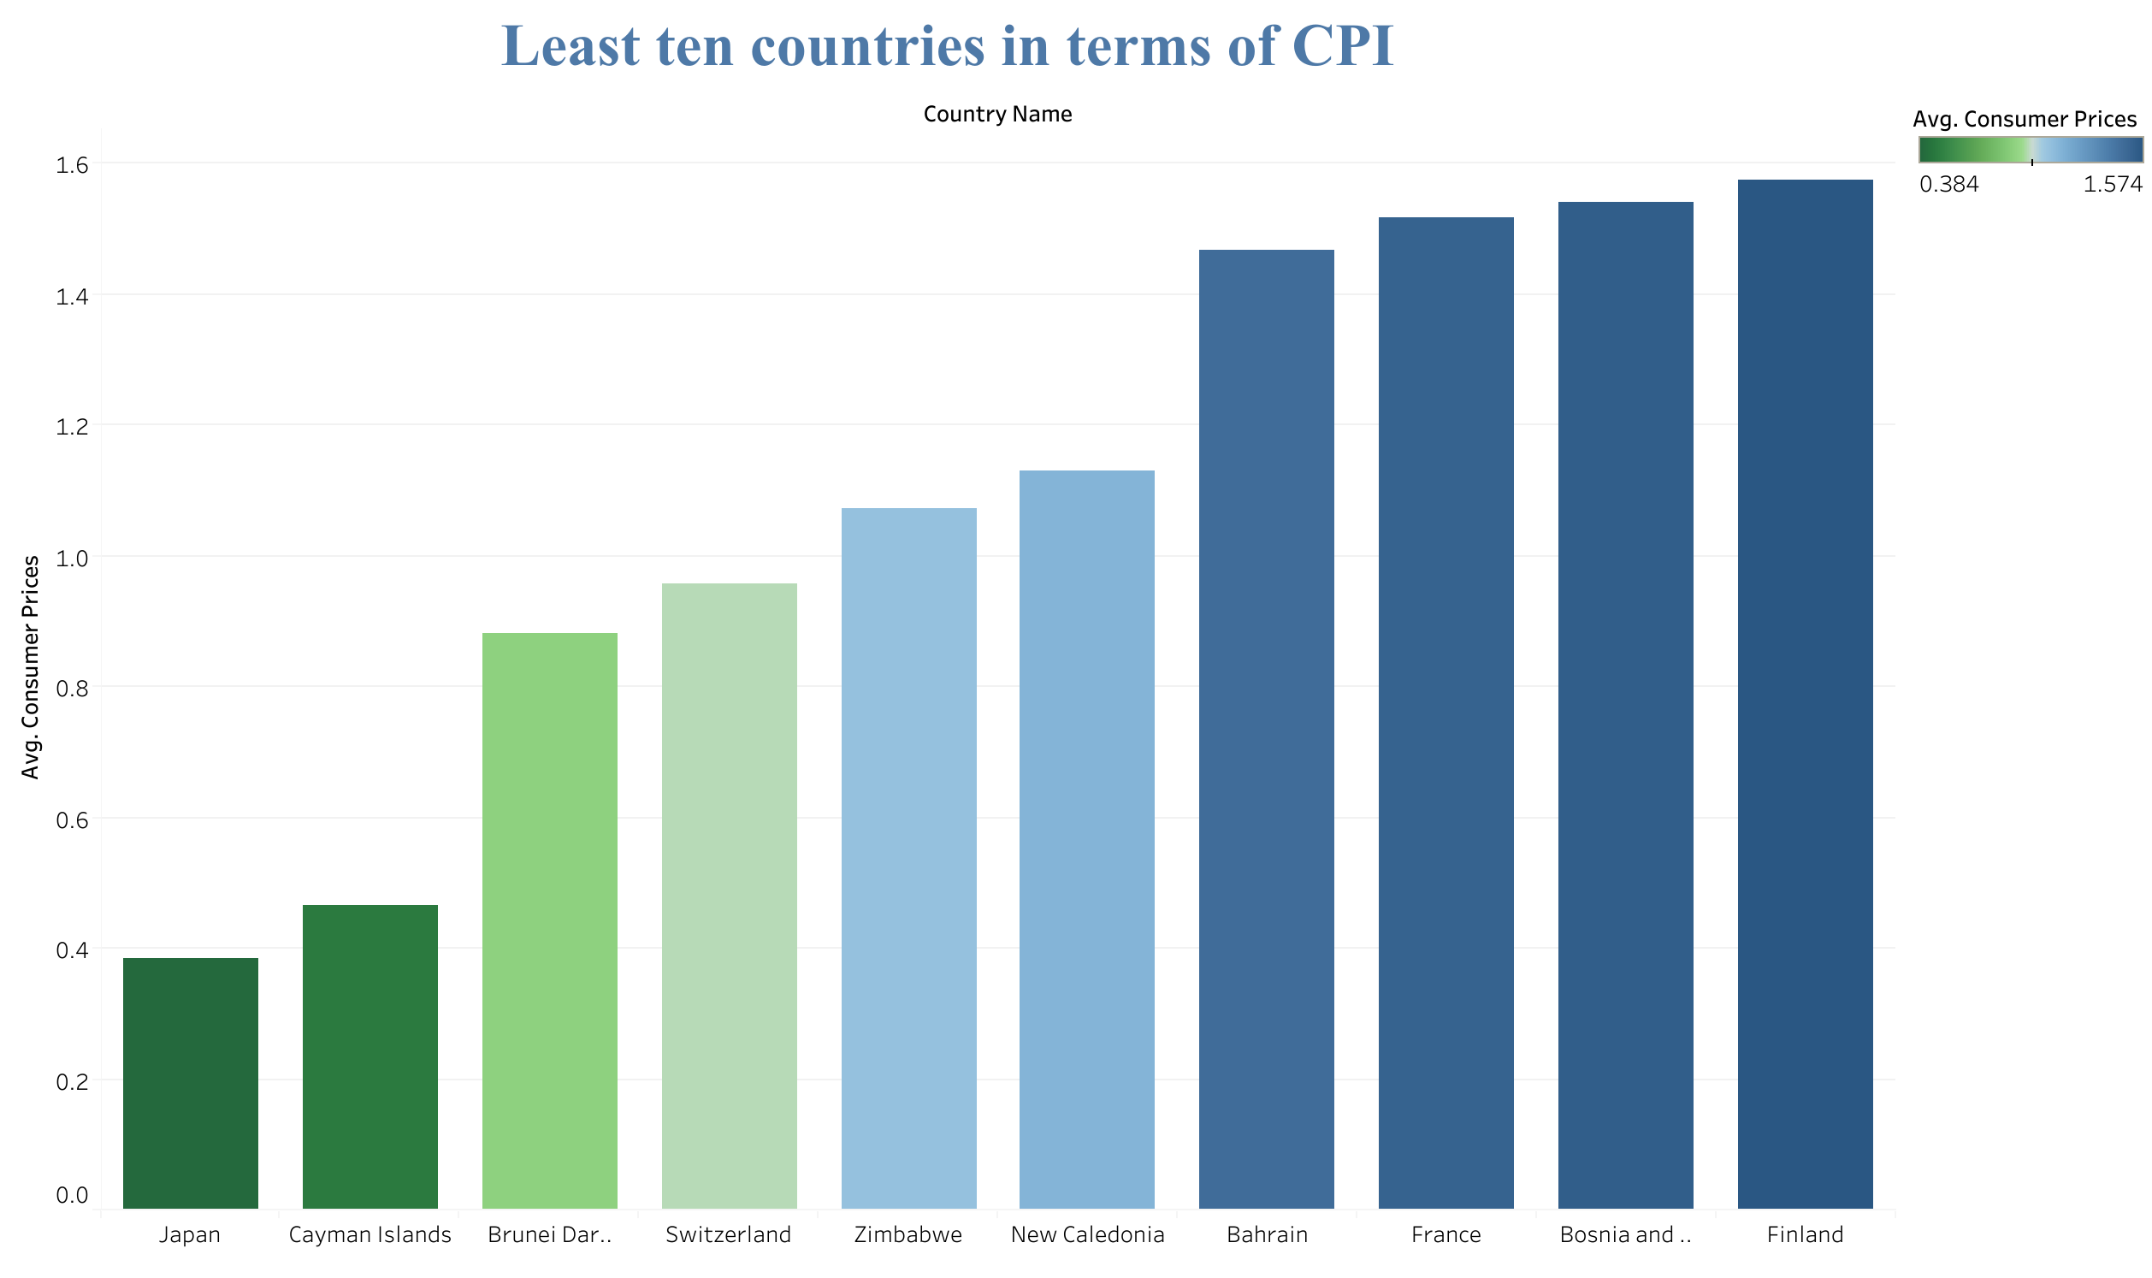
Answer Q 5: What are the least ten countries in terms of CPI?
Answer Here
1. JAPAN
2. CAYMAN ISLANDS
3. BRUNEI DARUSSALAM
4. SWITZERLAND
5. ZIMBABWE
6. NEW CALEDONIA
7. BAHRAIN
8. FRANCE
9. BOSNIA AND HERZEGOVINA
10. FINLAND
GDP of these countries is High compared with the countries of the world

Slide 12
Introduction
Questions !
Answers !
References

Slide 13
References
The International Monetary Fund (IMF)
Sourse : https://data.imf.org/?sk=388DFA60-1D26-4ADE-B505-A05A558D9A42&sId=1479329334655
Binance
sourse : https://www.binance.vision/economics/the-2008-financial-crisis-explained
Diffen
sourse : https://www.diffen.com/difference/Income_vs_Revenue

